Slide 1
Topic: Statistics
EQ: How can I find the mean, median, mode and range of numbers?

Slide 2
Five questions (LHS)

Slide 3
Topic: Statistics
EQ: How can I find the mean, median, mode and range of numbers?
What are data measures?
There are four data measures which help us analyse data.
Mean
Median
Mode
Range
What is the maximum and minimum number?
Maximum number – Largest number in the data set
Minimum number – Smallest number in the data set

Slide 4
Topic: Statistics
EQ: How can I find the mean, median, mode and range of numbers?
What is the median?
The middle number when the data is in order.
5, 7, 3, 4, 3, 5, 3
Ascending order: 3, 3, 3, 4, 5, 5, 7
Median = 4 (4 is in the middle)

Slide 5

Topic: Statistics
EQ: How can I find the mean, median, mode and range of numbers?
What is the mean?
Mean is the average.
The mean describes the middle of all the numbers.
Add all of the numbers together
Divide by how many numbers there are
1, 2, 3, 4, 4
$$Mean= \frac{Sum of scores}{Number of scores}$$
$$Mean= \frac{1+2+3+4+4}{5}$$
Mean = 2.8

Slide 6
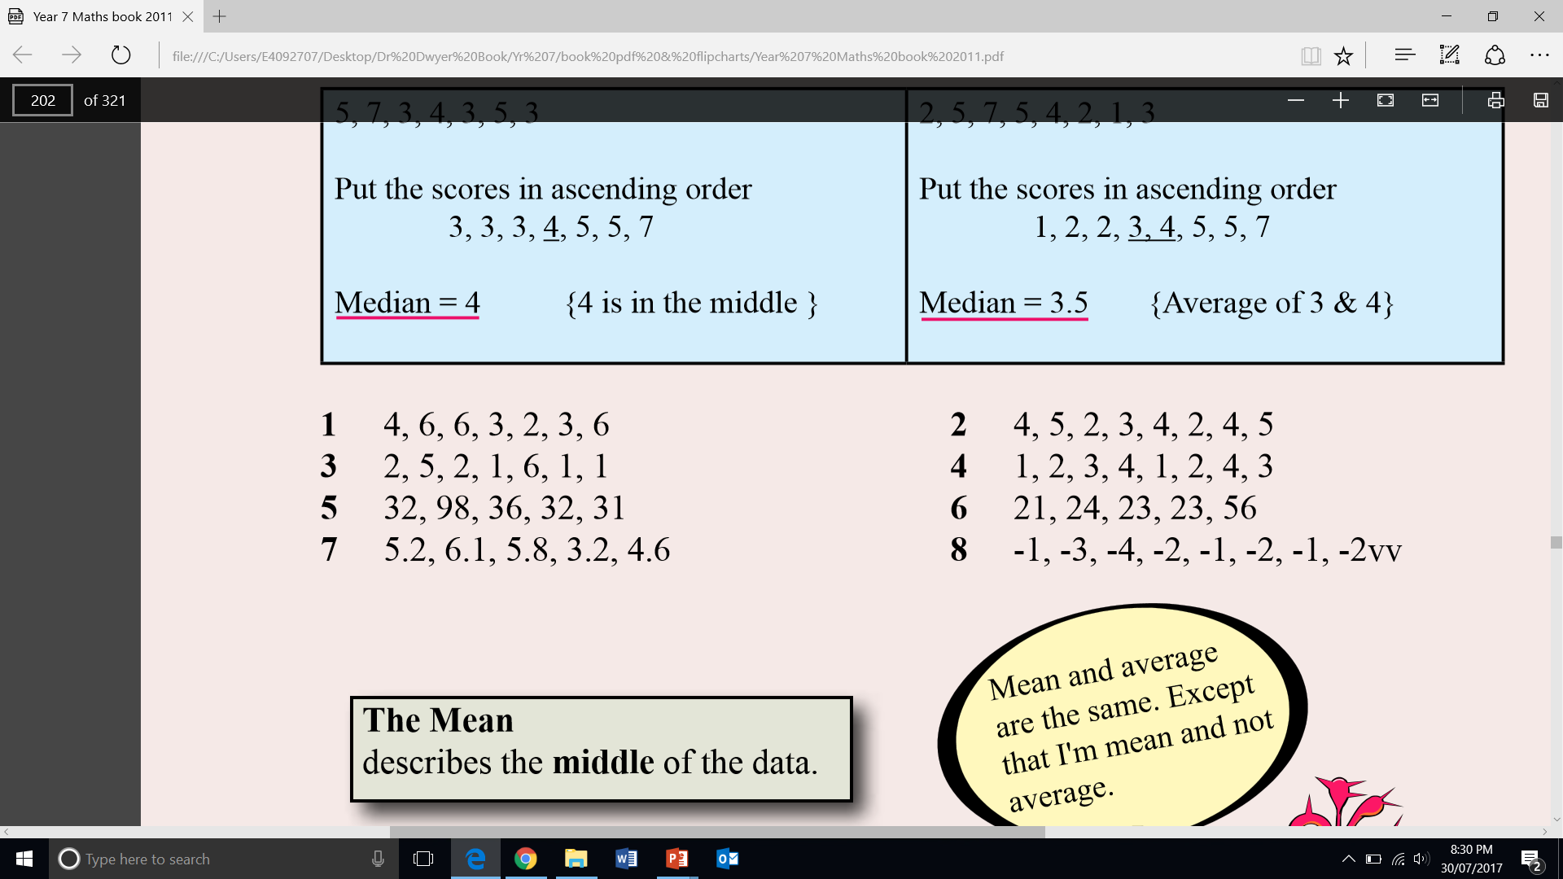
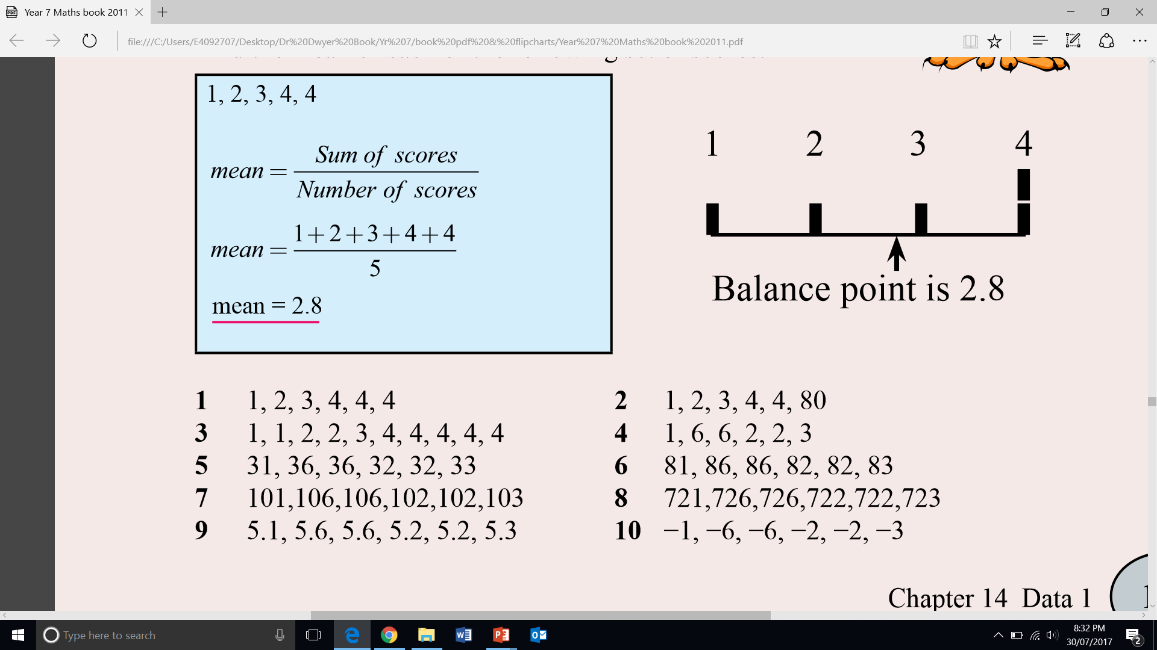
Guided practice
Find the median:
Find the mean:

Slide 7
independent practice
Find the median:
Find the mean:

Slide 8
Topic: Statistics
EQ: How can I find the mean, median, mode and range of numbers?
What is the range?
The range describes how spread out the data is.
Distance from the smallest number to the largest
Range = Maximum number – Minimum number
What is the mode?
Mode describes the score that occurs the most often.
1, 1, 4, 6, 6, 7, 8, 11, 12, 12, 12, 15
Minimum number: 1
Maximum number: 15
Range: 15 - 1 = 14 Mode: 12 (occurs 3 times)

Slide 9
Guided Practice
Minimum
Maximum
Range
Mode
Minimum
Maximum
Range
Mode
4, 7, 15, 15, 23, 31, 43
2, 7, 2, 6, 3, 2, 6, 7
Put in order
2, 2, 2, 3, 6, 6, 7, 7

Slide 10
Exit pass
Exit Pass
9, 2, 15, 7, 3, 21, 2, 1, 11, 20
On a piece of paper, write the mean, median, mode and range for the above set of numbers
Hand in to me when done and complete summary

